Slide 1

Welcome to Professional Development Skills Part 1
Lecturer: …
Email: …
Module Leader: Kenneth Cohen
Email: kenneth.cohen@london.aru.ac.uk

Slide 2

Week 1 - In Today’s class
First Meeting
The Assignment Brief
The Employability Scheme
Introduction to PD1

Slide 3



First meeting

Slide 4
Getting to know you
In groups of 3s or 4s, find out the following information for your peers:
Your preferred names
The reasons you all chose to study at ARUL
One thing you are nervous about being at university
One thing you are looking forward to being at university
Something that you all have in common as a group

Slide 5

INTRODUCTION TO PD1

Slide 6
Discovering PD1
The first part of the professional development skills module is designed to guide you through exploring a career that you may potentially wish to pursue in the future, and to provide you with some basic employability skills. Let’s find out more:
Log in to your VLE account at https://learnarul.uk/login/index.php (do NOT use the https://arulondon2.org/vle/login.php address) or by using the MyARUL app.
Go to the Professional Development Skills 1 tile.
Click on the tile for Week 1.
Download the 2 documents titled: PD1 Week 1 – Worksheet and PD1 Week 1 – Module Information.
Read the Module Information then complete in groups TASK 1 to 3 in the Worksheet.

Slide 7
The Career express model
We have noted that weeks 2 to 5 are organized around the Career’s Express Model. But what is that exactly?
Go to the tile for Week 1 on the VLE and download the pdf file entitled ‘PD1 Week 1 – Graduate Career Guidebook p.22-23’ and read about the model.
Look at the boxes in the next slide (also found in TASK 4 of the PD1 Week 1 - Worksheet document). Which of the stages does each box describe?

Slide 8
The Career express model - Answers
Station
Look for suitable positions that match your interests.
Station
Map out specifically what you need to do in order to reach your career goal.
Station
Link your abilities and interests to the positions that you have identified to pin point suitable positions.
Station
Decide what it is that you’re looking for professionally, and what skills and knowledge you can provide to a potential employer.
Station
Prepare yourself mentally for the journey ahead.
Station
Take your first steps to achieve your career goals.

Slide 9
The Career express model - REFLECTION
Discuss with your group:
Have you ever heard of similar models in the past?
Why do you think this model was chosen to organize the first part of your course?
How do you think this might be useful to you?

Slide 10
Setting expectations 1
To make the most of your learning:
Engage and participate in sessions proactively.
Be serious about completing your weekly tasks for PD1 (i.e. do your homework!).
Be positive and inclusive in your interactions with classmates and your lecturer.
Do not hesitate to ask questions if you’re are stuck, lost or don’t understand what is expected of you.

Slide 11
Setting expectations 2
There may be occasions where the topics covered raise difficult issues for you or your peers. In order to create a safe space to learn:
Respect the confidentiality of any personal information that is shared.
Speak to your Personal Development Tutor (PDT) and discuss a referral to the Student Welfare Team if you feel you need extra support.

Slide 12

The Assignment Brief

Slide 13
Getting to know the assignment brief
Go to the VLE tile for Week 1 and download the PD1 Week 1 – Assignment Brief document.
Take 5 minutes to go over the document.
Go to the website kahoot.it on your device. Enter the passcode displayed on the board and then enter your name. Get ready to answer the quiz!

Slide 14
Getting to know the assignment brief
Look again at the Assignment Brief then find the answers to the questions in TASK 6 of the PD1 Week 1 – Worksheet document. You will need to also look at the Scheme of Work contained in the PD1 Week 1 - Module Information document (p.2 of the file).

Slide 15

The employability scheme

Slide 16
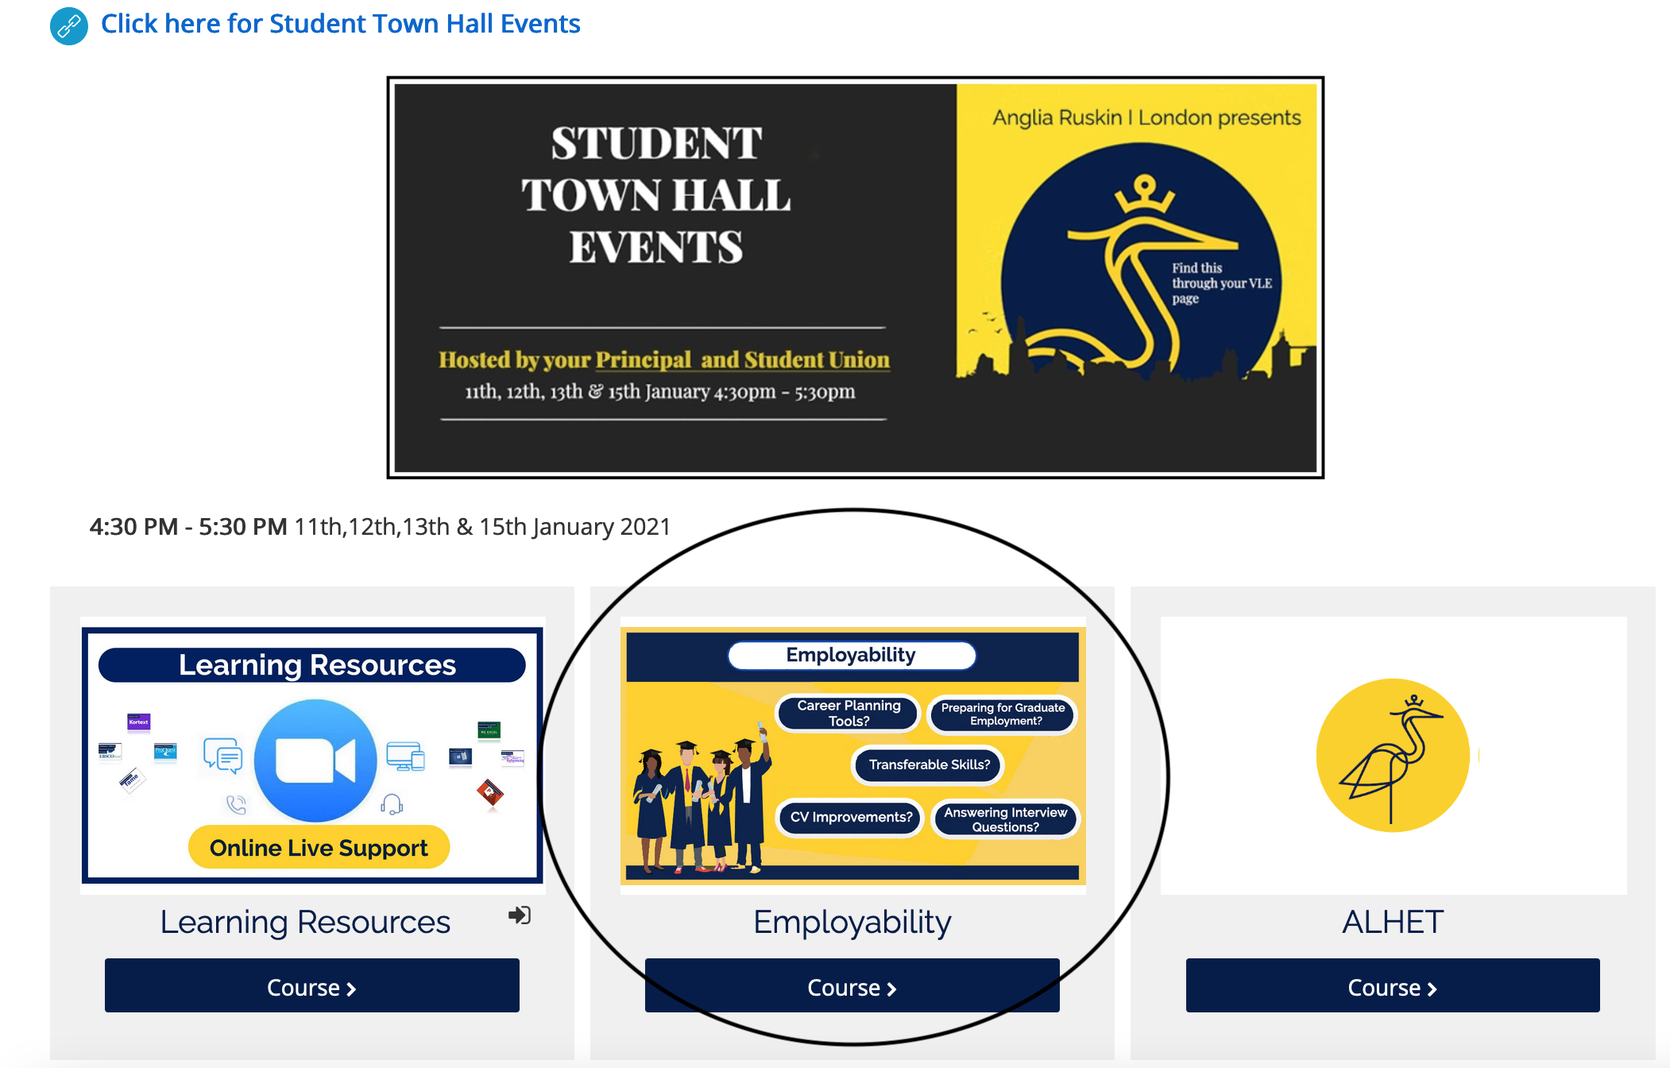
The employability team
On your VLE, you will have a tile titled 'Employability’.
This will be one of the key components you can utilise throughout your time with ARUL.
For level 3 students, the Bronze Passport Scheme will be made available to you shortly. Make sure to check it out.

Slide 17
The Employability scheme sessions
The employability team run the Bronze Scheme. Sessions run from weeks 1-5, with lunch time and evening sessions on the following topics on the right:
Introductory
Career Planning
Professional Skills
Your Personal Brand
CV Building
Interview Preparation
The sessions are not mandatory for ARUL students but we encourage you to participate as much as you can as they can help you become better prepare to join the workforce when you graduate.

Slide 18
The Employability scheme – Quick quiz
Look at the Bronze Passport Scheme timetable in TASK 6 of the PD1 Week 1 – Worksheet. Answer the four questions with your peers.
Will you make use of the Bronze Passport Scheme? Why/not?

Slide 19

Summary

Slide 20
Summary of PD1
The aim of PD1 is to foster self-reflection and assist students in formulating a basic career plan.
It also seek to develop skills fundamental to job seeking.
The course will make use of a variety of resources, including the PD1 reader and various websites.
Your assessment is a final individual interview, representing 50% of the Professional Development module (100% of this trimester).
Do not cheat for your exam: you will be caught out!
Be serious about your work in class and respect your peers in class.
Make use of the Bronze Passport Scheme.

